Slide 1
Maximum Flow
Chapter 26

Slide 2
Flow Graph
A common scenario is to use a graph to represent a “flow network” and use it to answer questions about material flows
Flow is the rate that material moves through the network
Each directed edge is a conduit for the material with some stated capacity
Vertices are connection points but do not collect material
  Flow into a vertex must equal the flow leaving the vertex, flow conservation

Slide 3
Sample Networks
Network
Nodes
Arcs
Flow
communication
telephone exchanges,
computers, satellites
cables, fiber optics,
microwave relays
voice, video,
packets
circuits
gates, registers,
processors
wires
current
mechanical
joints
rods, beams, springs
heat, energy
hydraulic
reservoirs, pumping
stations, lakes
pipelines
fluid, oil
financial
stocks, companies
transactions
money
transportation
airports, rail yards,
street intersections
highways, railbeds,
airway routes
freight,
vehicles,
passengers
chemical
sites
bonds
energy

Slide 4
Flow Concepts
Source vertex s
  where material is produced
Sink vertex t
  where material is consumed
For all other vertices – what goes in must go out
  Flow conservation
Goal: determine maximum rate of material flow from source to sink

Slide 5
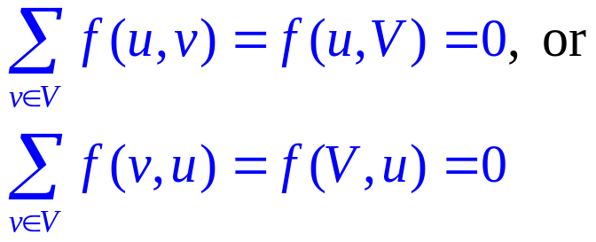
Formal Max Flow Problem
  Graph G=(V,E) – a flow network
    Directed, each edge has capacity c(u,v) ≥ 0
    Two special vertices: source s, and sink t
    For any other vertex v, there is a path s→…→v→…→t
  Flow – a function f : V × V → R
    Capacity constraint: For all u, v ∈ V: f(u,v) ≤ c(u,v)
    Skew symmetry: For all u, v ∈ V: f(u,v) = –f(v,u)
    Flow conservation: For all u ∈ V – {s, t}:
2/15
a
4/19
s
0/9
2/5
t
5/14
b
3/3

Slide 6
Cancellation of flows
We would like to avoid two positive flows in opposite directions between the same pair of vertices
  Such flows cancel (maybe partially) each other due to skew symmetry
2/15
a
5/19
2/15
a
5/19
s
2/9
5/5
t
s
0/9
t
3/5
5/14
b
2/3
5/14
b
2/3

Slide 7
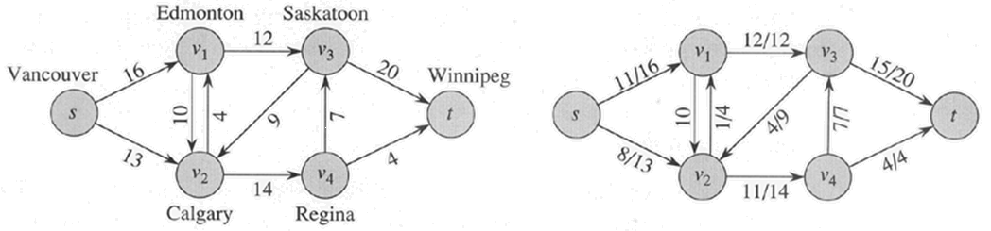
Max Flow
We want to find a flow of maximum value from the source to the sink
  Denoted by |f|
Lucky Puck Distribution Network
Max Flow, |f| = 19
Or is it?
Best we can do?

Slide 8
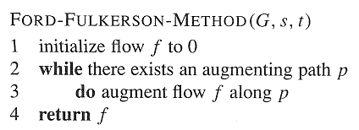
Ford-Fulkerson method
Contains several algorithms:
  Residue networks
  Augmenting paths
    Find a path p from s to t (augmenting path), such that there is some value x > 0, and for each edge (u,v) in p we can add x units of flow
      f(u,v) + x ≤ c(u,v)
Augmenting Path?
a
8/13
b
10/15
13/19
s
10
9
5/5
t
2/4
6/14
c
8/11
d
3/3

Slide 9
Residual Network
To find augmenting path we can find any path in the residual network:
  Residual capacities: c_{f}(u,v) = c(u,v) – f(u,v)
    i.e. the actual capacity minus the net flow from u to v
    Net flow may be negative
  Residual network: G_{f} =(V,E_{f}), where
    E_{f} = {(u,v) ∈ V × V : c_{f}(u,v) > 0}
  Observation – edges in E_{f} are either edges in E or their reversals: |E_{f}| ≤ 2|E|
5/15
10
Sub-graph
With
c(u,v) and
f(u,v)
Residual
Sub-Graph
a
b
5/6
a
b
1
c
c
0/14
19
5

Slide 10
Residual Graph
Compute the residual graph of the graph with the following flow:
a
8/13
b
10/15
13/19
s
10
9
5/5
t
2/4
6/14
c
8/11
d
3/3

Slide 11
Residual Capacity and Augmenting Path
Finding an Augmenting Path
  Find a path from s to t in the residual graph
  The residual capacity of a path p in G_{f}:
  c_{f}(p) = min{c_{f}(u,v): (u,v) is in p}
    i.e. find the minimum capacity along p
  Doing augmentation: for all (u,v) in p, we just add this c_{f}(p) to f(u,v) (and subtract it from f(v,u))
  Resulting flow is a valid flow with a larger value.

Slide 12
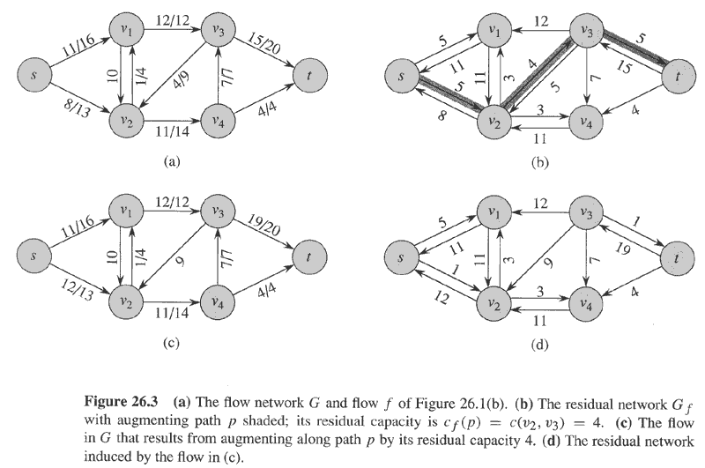
Residual network and augmenting path

Slide 13
The Ford-Fulkerson method
Ford-Fulkerson(G,s,t)
1 for each edge (u,v) in G.E do
2 f(u,v) ← f(v,u) ← 0
3 while there exists a path p from s to t in residual network G_{f} do
4 c_{f} = min{c_{f}(u,v): (u,v) is in p}
5 for each edge (u,v) in p do
6 f(u,v) ← f(u,v) + c_{f}
7 f(v,u) ← -f(u,v)
8 return f
The algorithms based on this method differ in how they choose p in step 3.
If chosen poorly the algorithm might not terminate.

Slide 14
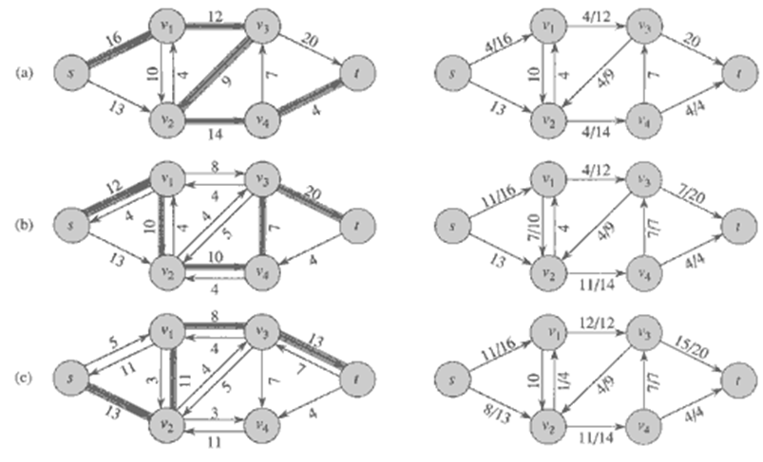
Execution of Ford-Fulkerson (1)
Left Side = Residual Graph Right Side = Augmented Flow

Slide 15
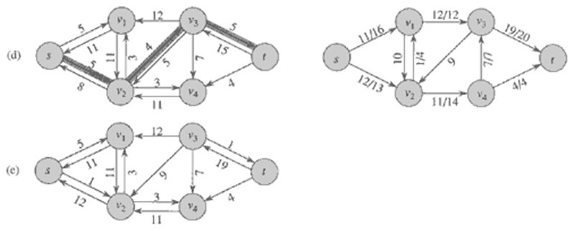
Execution of Ford-Fulkerson (2)
Left Side = Residual Graph Right Side = Augmented Flow

Slide 16
Cuts
Does the method find the minimum flow?
  Yes, if we get to the point where the residual graph has no path from s to t
  A cut is a partition of V into S and T = V – S, such that s ∈ S and t ∈ T
  The net flow (f(S,T)) through the cut is the sum of flows f(u,v), where s ∈ S and t ∈ T
    Includes negative flows back from T to S
  The capacity (c(S,T)) of the cut is the sum of capacities c(u,v), where s ∈ S and t ∈ T
    The sum of positive capacities
  Minimum cut – a cut with the smallest capacity of all cuts.
  |f|= f(S,T) i.e. the value of a max flow is equal to the capacity of a min cut.
a
8/13
b
10/15
13/19
s
10
9
5/5
t
2/4
6/14
c
8/11
d
3/3
Cut capacity = 24
Min Cut capacity = 21

Slide 17
Max Flow / Min Cut Theorem
Since |f| ≤ c(S,T) for all cuts of (S,T) then if |f| = c(S,T) then c(S,T) must be the min cut of G
This implies that f is a maximum flow of G
This implies that the residual network G_{f} contains no augmenting paths.
  If there were augmenting paths this would contradict that we found the maximum flow of G
1→2→3→1 … and from 2→3 we have that the Ford Fulkerson method finds the maximum flow if the residual graph has no augmenting paths.

Slide 18
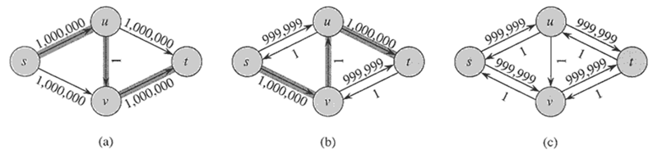
Worst Case Running Time
Assuming integer flow
Each augmentation increases the value of the flow by some positive amount.
Augmentation can be done in O(E).
Total worst-case running time O(E|f*|), where f* is the max-flow found by the algorithm.
Example of worst case:
Augmenting path of 1
Resulting Residual Network
Resulting Residual Network

Slide 19
Edmonds Karp
Take shortest path (in terms of number of edges) as an augmenting path – Edmonds-Karp algorithm
  How do we find such a shortest path?
  Running time O(VE²), because the number of augmentations is O(VE)
  Skipping the proof here
  Even better method: push-relabel, O(V²E) runtime

Slide 20
Multiple Sources or Sinks
What if you have a problem with more than one source and more than one sink?
Modify the graph to create a single supersource and supersink
13
a
13
b
15
a
b
13
15
13
10
t
i
10
9
5
k
s
4
9
5
4
∞
∞
14
11
3
14
c
11
d
3
c
d
t
s
4
4
13
e
13
f
15
e
f
13
15
13
∞
∞
10
y
j
10
9
5
l
x
4
9
5
4
14
11
3
14
g
11
h
3
g
h

Slide 21
Application – Bipartite Matching
Example – given a community with n men and m women
Assume we have a way to determine which couples (man/woman) are compatible for marriage
  E.g. (Joe, Susan) or (Fred, Susan) but not (Frank, Susan)
Problem: Maximize the number of marriages
  No polygamy allowed
  Can solve this problem by creating a flow network out of a bipartite graph

Slide 22
Bipartite Graph
A bipartite graph is an undirected graph G=(V,E) in which V can be partitioned into two sets V₁ and V₂ such that (u,v) ∈ E implies either u ∈ V₁ and v ∈ V₁₂ or vice versa.
That is, all edges go between the two sets V₁ and V₂ and not within V₁ and V₂.

Slide 23
Model for Matching Problem
Men on leftmost set, women on rightmost set, edges if they are compatible
A
A
X
A
X
X
B
B
B
Y
Y
Y
C
C
C
Z
Z
D
Z
D
D
Men
Women
A matching
Optimal matching

Slide 24
Solution Using Max Flow
Add a supersouce, supersink, make each undirected edge directed with a flow of 1
A
A
X
X
B
B
t
Y
s
Y
C
C
Z
Z
D
D
Since the input is 1, flow conservation prevents multiple matchings

